Slide 1
Unit 4: Physiology ad Anatomy Knowledge Organiser
The sensory systems, malfunctions and their imapt on individuals.

Slide 2
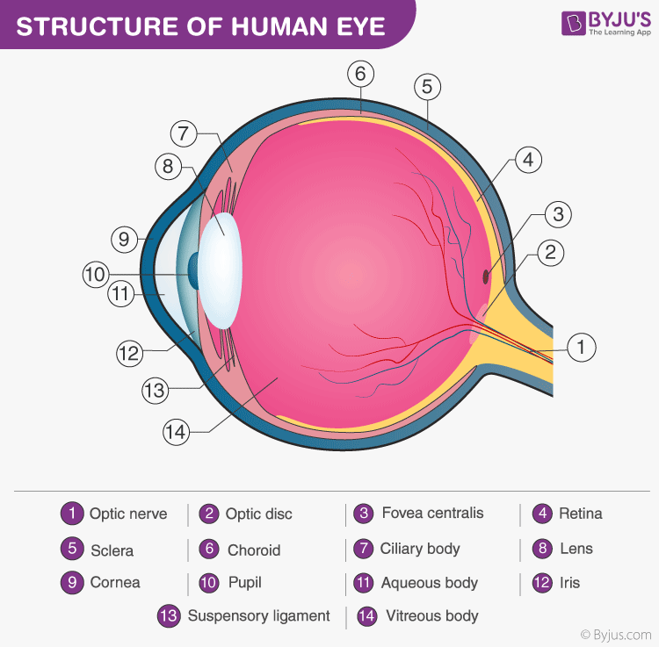
The Eye
Structure of the eye:
Pupil –light passes through this opening in the middle of the eye
Iris – visible coloured ring at the front of the eye, it adjusts to the amount of light entering the eye through the pupil.
Tear glands – also known as the lacrimal glands – produce tears to clean and lubricate the eye. Tears contain salt which is a natural antiseptic – has the ability to defend against infection.
Aqueous and vitreous humours – watery, jelly-like fluids that fill the eye – keeping the eye in shape and nourishing it.
Conjunctiva – thin membrane which protects the cornea.
Cornea - transparent front of the eye, light t=rays pass though it to the retina.
Retina – inner lining of the eye – contains light sensitive cells that are called rod and cones.
Macula – high concentration of photoreceptor cells, these detect light ad send signals to the brain – this then interprets them as images.
Optic nerve – where the nerve cells exit the eye – no rods or cones so known as the blind spot.
Ciliary muscle – enables the lens to change shape for focusing – contracts to stretch to the lens, making it flatter and thinner.
Supersensory ligaments – attached to the ciliary muscle.
Lens – focuses light entering the eye.
Exam Tip:
Make sure you can label a diagram of the eye.

Slide 3
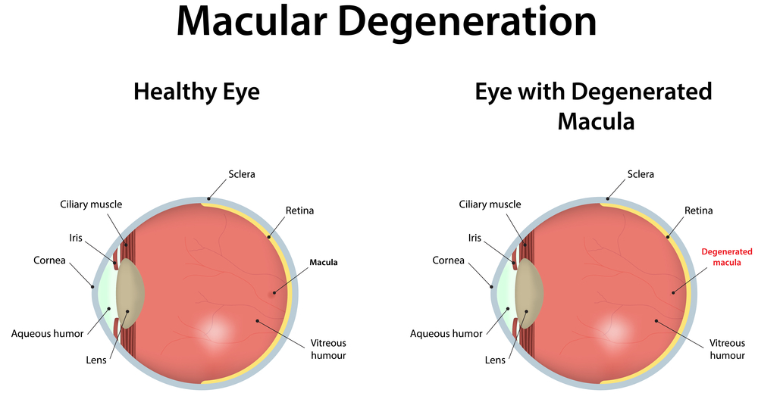
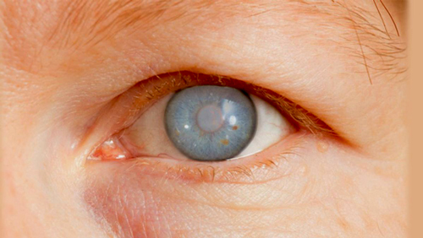
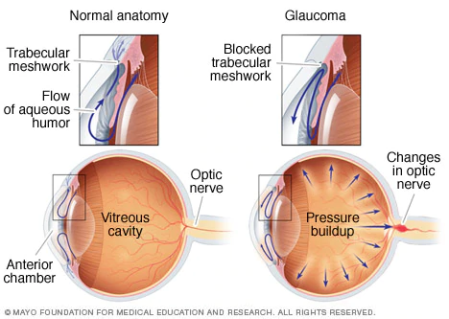
Malfunctions of the eye:
Glaucoma
Possible causes:
Most cases are caused by a build up of pressure in the eye due to the fluid from the aqueous humour isn’t able to drain properly – causing damage to the optic nerve.
Risks can be increased by:
Age – glaucoma more common as you get older.
Ethnicity – African, Caribbean or Asian origin have a higher risk of having this condition.
Family history – if a parent or sibling has the condition you are more likely to be at risk.
Other medical conditions like diabetes make it more likely.
Effects:
Glaucoma – tends to develop slowly over a number of years and affects the peripheral vision (edges of vision)
Most people don’t realise they have it, typically discovered at a routine eye test.
Symptoms that can be experienced include – blurred vision or seeing rainbow coloured circles when in bright light.
Untreated the build up of fluid presses on the optic nerve – destroying it and over time causing blindness.
Age related macular degeneration: (AMD)
Possible causes:
AMD linked to smoking, obesity, high blood pressure and family history of the condition – the exact cause is unknown.
Effects:
Makes everyday activities like reading and recognising faces more difficult as there is a gradual loss of central vision but not total blindness.
Without any treatment, vision could get worse – either gradually over years (dry AMD) or quickly in months (wet AMD)depending on the type.
Straight lines are seen as crooked or wavy.
Things look smaller than normal.
Colours aren’t as bright as they used to be.
Hallucinations (seeing things that aren’t there).

Slide 4
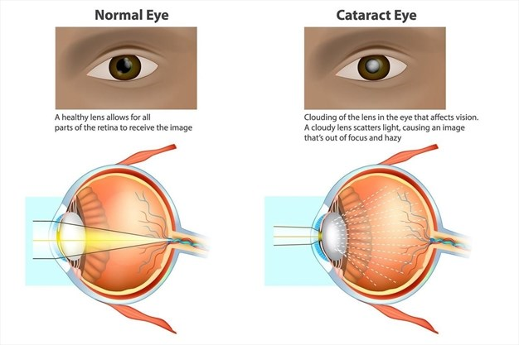
Cataracts:
Possible causes:
Diabetes
Exposure to Ultra-violet (UV) light in sunlight.
Medications like corticosteroids or statins for a long period of time.
Smoking
Heavy drinking
Family history of cataracts.
Effects:
Lens changes – caused by ageing, results in cloudy patches developing in the lens.
Cloudy, misty or blurred vision.
Colours appear less clear or paler.
Small patches of vision that isn’t as clear.
Dazzled or uncomfortable in bright light.
Harder to see in dim lor bright light. Bright light may cause discomfort to look at.
Double vision.
Retinopathy:
Possible causes:
Diabetes complication – caused by high blood sugar levels that damage the retina over time. Over time, high blood sugar levels cause blood vessels to narrow and leak = abnormal blood flow to the retina resulting in cells in the retina being damaged.
Effects:
If untreated or undiagnosed – can cause blindness

Slide 5
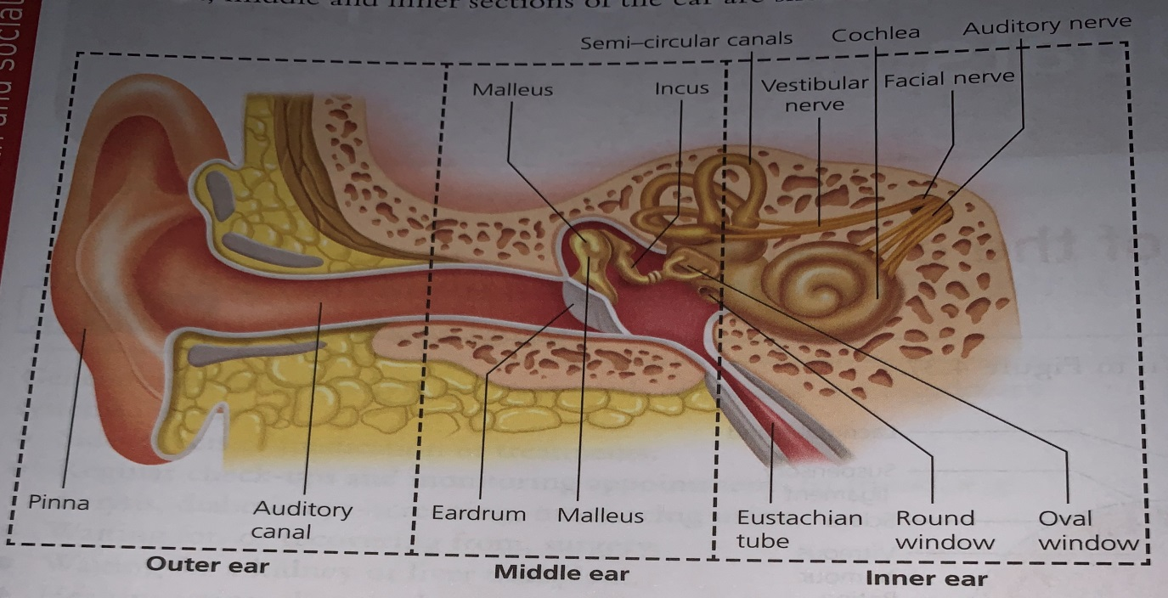
The Ear:
Malfunctions of the eye – monitoring and treatment
Glaucoma: treatments aim to reduce the pressure in the eye or prevent vision worsening.
Eye drops administered daily – self administered.
Regular eye appointments to monitor the condition and check the eye drops are working.
Laser treatment to open up blocked drainage tubes or to reduce the fluid production in the eye.
Surgery to improve the fluid drainage.
AMD:
Dry AMD –
no treatment to cure the condition, advised top stop smoking, healthy diet with plenty of leafy green vegetables and taking dietary supplements to slow the progression of the condition.
Wet AMD:
Scans to monitor the condition – regular.
Injections in to the eye – monthly to begin with and then reduced if possible, but ongoing.
Photodynamic therapy – laser treatment, a light sensitive dye is injected into the eye and a laser used to activate the dye to destroy abnormal blood vessels.
Cataracts:
Regular eye examinations to monitor the condition.
Stronger glasses and brighter reading lights help for a while.
Surgery will be needed to remove the lens and replace it (one eye at a time to make sure it works well)
Retinopathy:
Blood sugar levels monitored and controlled as well as blood pressure and cholesterol checks.
Diabetic eye screening appointments.
Medication injected into the eyes.
Laser treatment.
Scar tissue removed in surgery.
Eardrum – also known as the tympanic membrane – thin layer of tissue that receives sound vibrations and transmits them to the middle ear cavity.
Stapes/incus/malleus ear bones – also known as the stirrup/anvil and hammer are small bones that amplify sound waves and transmit vibrations across the middle ear to the cochlea.
Cochlea – contains a jelly like fluid in a coiled tube (a bit like a snail’s shell) – vibrations pass through the fluid and are converted into neural messages and passed via the auditory nerve to the brain.
Organ of corti – locate din the cochlea, it is lined with rows of hair cells that convert sound vibrations into nerve impulses.
Eustachian tube – connects the middle ear to the throat, ensure the pressure in the middle ear is equal to the pressure outside the ear.
Round window – a drum-like membrane, vibration from the oval window pass through to the cochlea.
Auditory nerve – bundle of nerve fibres that carry hearing information between the cochlea and the brain.
Semi-circular canals and ampullae – tiny fluid filled tubes in the inner ear that help with balance – they have nothing to do with hearing. They are lined with cilia and as the movement of the cilia are communicated with the brain, they work a bit like a motion sensor and help us to keep out balance.

Slide 6
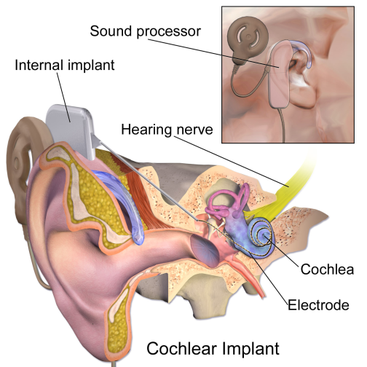
Malfunctions of the ear:
Deafness:
Gradual hearing loss – can be due to ageing exposure to loud noises over many years (like factory noise)
Conductive hearing loss – could be as a result of a blockage caused by earwax or as a result of infection and a build up of fluid, a perforated ear drum or changes in oestrogen levels in women – for example during pregnancy. It could also be a genetic trait.
Sensorineural hearing loss – caused by damage to the hair cells in the inner ear or damage to the auditory nerve. Can be caused by viral infections like; mumps, measles, and meningitis. or a blow to the head or exposure to an extremely loud noise like an explosion.
Effects:
Difficulty hearing people clearly or misunderstanding what they are saying.
Having to ask people to repeat themselves.
Difficult to hear people on the phone.
More tricky to keep up with a conversation.
Having to turn the volume up on the TV or music – louder than most need it.
Complete loss of hearing = deafness leading to needing a hearing aid or implant.
Ear wax can be softened with ear drops or sucked out.
Hearing aid.
Implants – devices attached to the skull or placed deep inside the ear, for example cochlea implant.
Learning new communication methods like sign language or lip reading
Exam Tips:
Make sure you know the different parts of the eye and their functions and use the correct terminology in your exam responses.
Know the different parts of the year and use accurate terminology in question responses.
For malfunctions of both the eye and ear, know some possible causes and effects of each malfunction.
Be able to describe treatments for both eye and ear malfunctions.
Revision Activities:
Practice labelling both eye and ear diagrams.
Use your knowledge of the ear and create a flow chart to show how sound reaches the brain.
Create flashcards for malfunctions, including; causes, effects, monitoring and treatments.
Check your knowledge, try these questions:
What is the function of the (a) iris (b) macula (c) lens? (3 marks)
Describe the function of the tear glands (2 marks)
State the function of the ear drum. (1 mark)
What is the biological cause of glaucoma? (3 marks)
Give four examples how AMD can affect vision? (4 marks)
How does a lens change when affected by cataracts? (1 mark)
Describe the cause of retinopathy. (6 marks)
State four causes of deafness. (4 marks)

